Slide 1
Overview of HIV Testing:
CDC Recommendations, WV Law, Implementation
Carolyn Kidd RN ACRN
Clinical Nurse Educator
MidAtlantic AETC
WV Regional Partner

Slide 2
Disclosure
The MidAtlantic AIDS Education and Training Center does not endorse or recommend any commercial products, processes, or services. The representations and opinions expressed in this presentation are solely those of the author(s) and do not represent the views or policies of MA AETC, the University of Pittsburgh, or its funding agencies.
The staff and faculty involved with the planning of today’s event do not have any conflicts of interest to disclose.
Notes:
READ SLIDE

Slide 3
Speaker Disclosure
Speakers are required to disclose any commercial relationships before today’s presentation.
Notes:
*Start Audio*
At this time I would ask our speaker to please disclose any commercial relationships that he/she may have.

Slide 4
Needs
We have attempted to make this presentation compliant with the Americans with Disabilities Act and Section 508 of the Rehabilitation Act.
If you find that you need further accommodation, or alternate means to utilize this presentation, please contact us and we will attempt to further accommodate your needs.

Slide 5
Objectives
Identify changes made to the West Virginia HIV testing laws to be in conformity with the CDCs recommendations for HIV testing of adults and adolescents in the US
Outline the differences between current HIV testing methods approved for use in the United States by the FDA
Discuss how HIV testing and implementation of HIV testing in primary care centers have had an impact on reduction in disease transmission and new HIV infections in the United States

Slide 6



HIV Testing

Slide 7
HIV Testing in the US
Testing identifies undiagnosed HIV
Reduces risk of transmission to others
Prevalence of high-risk sexual behavior is reduced substantially after people become aware of their HIV positive status¹
Timely knowledge of status critical in improvement of health by linkage to care, treatment and prevention: decreased morbidity and mortality

Slide 8
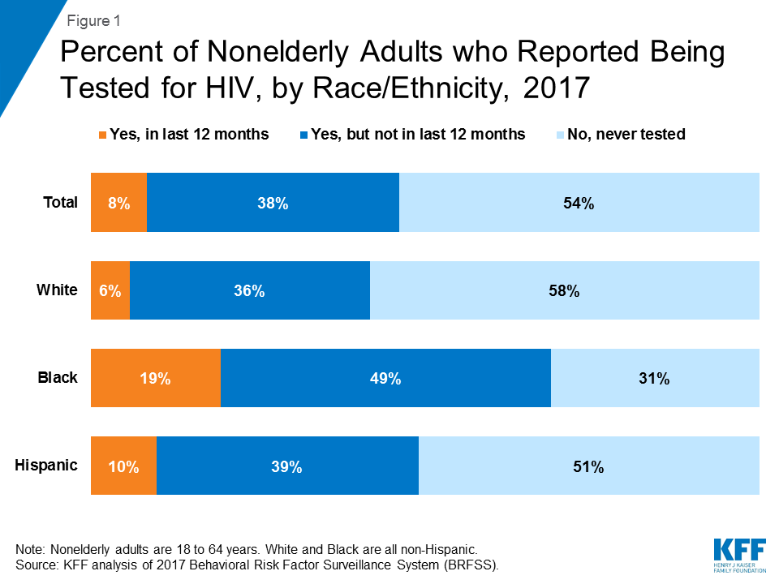
US Testing Statistics - 2017

Slide 9
United States testing statistics
Among those receiving an HIV diagnosis during 2013, 24% were simultaneously diagnosed with AIDS:
  likely infected for many years without knowing it
  late diagnoses = missed opportunities for treatment and prevention
Poverty can limit access to:
  health care
  HIV testing
  Medications that can lower levels of HIV in the blood and help prevent transmission risk
Discrimination, stigma and LGBTQ phobia:
  Discrimination, stigma and LGBTQ phobia:

Slide 10
Revised CDC HIV Testing Recommendations
Released September 2006
Rationale and Objectives:
  Increase the number of people who know their HIV status thereby reducing the number of new infections
  Increase HIV screening of patients, including pregnant women in health care settings
  Foster earlier detection of HIV disease
  Identify persons with unrecognized HIV, counsel and link to services
  Further reduce perinatal transmission

Slide 11
Revised CDC HIV Testing Recommendations
Screening for HIV infection:
  In health care settings: routine, voluntary HIV screening for ALL persons 13-64
  All patients initiating TB treatment should be routinely screened for HIV
  All patients seeking treatment for STIs should be screened routinely for HIV during each visit for a new complaint
Notes:
HIV infection is the most important known risk factor for progression from latent TB infection to TB disease. Progression to TB disease is often rapid among people infected with HIV and can be deadly. In addition, TB outbreaks can rapidly expand in patient groups infected with HIV.

Slide 12
Revised CDC HIV Testing Recommendations
Repeat screening of those with known risk annually ie:
  IDUs and their sex partners
  Those who exchange sex for money, drugs, or…
  Sex partners of those infected with HIV
  MSM/hetero and their partners who have had > 1 sex partner since their most recent HIV test
For those not at high risk:
  should be based on clinical judgment

Slide 13
Revised CDC HIV testing recommendations
Consent and pretest information:
  Voluntary and only with patient knowledge and understanding
  Opt-out screening with opportunity to ask questions and option to decline
  Include HIV consent with general consent for care; separate signed informed consent not recommended
  Prevention counseling in conjunction with HIV testing and screening should not be required

Slide 14
Pregnant Women and STDs
STDs affect women of every socioeconomic and educational level, age, race, ethnicity, and religion.
The CDC 2015 STD Treatment Guidelines recommend pregnant women be screened for STDs and include:
  Chlamydia
  Gonorrhea
  Hepatitis B
  HIV
  Syphilis
  Hepatitis C (born between 1945-1965 or if risk factors are present)

Slide 15
Revised CDC testing recommendations
Pregnant women
  Universal opt-out HIV screening
  Include HIV in routine panel of prenatal screening tests
  Consent for prenatal care includes HIV testing
  Notification & option to decline
Second test in 3rd trimester for pregnant women who are:
  Known to be at risk for HIV
Regulations, laws, & policies about HIV screening of pregnant women vary state to state

Slide 16
Revised CDC testing recommendations
Pregnant women:
  Opt-out rapid testing for women with undocumented HIV status in L&D
  Initiate ARV prophylaxis within 12 hours on basis of rapid test result
Rapid testing of newborn recommended if mom’s status unknown at delivery

Slide 17
WV HIV testing law
Voluntary
Recommended as routine part of screening
Targeted testing:
  High-risk behavior: screen annually
  If test proves important for patient care
  Significant occupational exposure
  No record of testing an mom presents in labor
Disclosure:
  Notification to sexual partners is not required
Minor/adolescent testing:
  Minors may consent to STI testing, HIV not explicitly included

Slide 18
WV HIV Testing Law
Inform patient orally/in writing that HIV testing will be performed as part of routine care
General consent for medical care includes consent for HIV testing
Opt-out (patient may decline)
All HIV testing must be available anonymously
No opt-out option:
  Tissue/organ/blood/semen donation
  Documented, bona fide medical emergency
  Purpose of research

Slide 19
WV HIV Testing Laws
Prenatal:
  Recommended as part of routine prenatal/perinatal care
  Included with general consent (pt. must be informed)
  Opt-out
  Second test in 3rd trimester (preferably prior to 36 weeks)
Labor and delivery, neonatal:

Slide 20
WV HIV Testing Law
Mandated Testing:
  No consent, must include counseling
On any person charged with the following:
  Prostitution
  Sexual abuse, assault, incest, molestation
    Confidential, administered by local/county health dept or regional jail
On any person convicted of the above charges

Slide 21
WV HIV Testing Sites
All County Health Departments
  Cabell/Huntington, Kanawha/Charleston: Rapid HIV Testing
Universities – some use rapid testing
Free Clinics
June 27 – National HIV Testing Day (events all over)

Slide 22
Testing Technologies

Slide 23
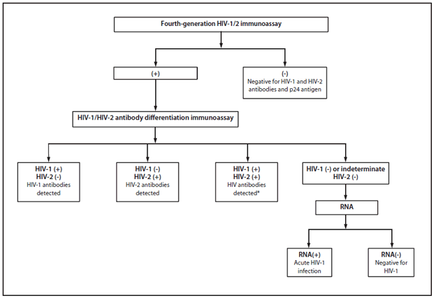
New HIV Diagnostic Testing Algorithm
Abbott Architect™ or PANTHER™
Identifies Ag and Ab
Multi-spot
INSTI™
Viral load testing
Notes:
1. An FDA approved 4th generation HIV 1&2 immunoassay (1A) should be used as the initial test, to screen for acute HIV -1 infection and for established infections with HIV-1 or HIV -2.
2. Specimens with a reactive 4th generation IA should be tested with an FDA approved 2nd generation antibody IA that differentiates HIV-1 antibodies from HIV -2 antibodies.
3. Persons whose specimens give positive results on the initial IA and HIV-1/HIV-2 antibody differentiation IA should be considered positive for HIV-1 or HIV-2 antibodies and should initiate medical care that includes lab tests (such as vl, CD4, and ARV resistance assays) to confirm the presence of HIV infection, to stage HIV disease, and to assist in the selection of an initial ARV drug regimen.
4. Specimens that are reactive on the initial assay and negative on the HIV-1/HIV -2 antibody differentiation IA should be tested with an FDA approved nucleic acid test (NAT) for HIV -1. Under these circumstances, a reactive NAT result indicates the presence of acute HIV-1 infection. A negative result indicates the absence of HIV-1 infection, either a false positive results on the initial IA or rarely, recent HIV-2 infection. There is no FDA approved NAT for HIV-2.
5. The same testing algorithm beginning with a 4th generation immunoassay should be followed for specimen from persons with a preliminary positive rapid HIV test result.
Additional testing required to rule out dual infection with HIV-1 and HIV-2.
Alternate Text: The figure above is a flowchart depicting the new human immunodeficiency virus (HIV) diagnostic algorithm, which replaces the Western blot test with an HIV-1/HIV-2 antibody differentiation assay as the supplemental test and includes an RNA test to resolve a reactive immunoassay with a negative supplemental test result.
Diagnostic Laboratory testing only
How these recommendations differ from previous recommendations:
Supersedes 189WB, 1992 HIV-2, and 2004 rapid test confirmation recommendations
Tests for both virologic (p24 antigen) and serologic (antibody) markers of HV infection
Incorporates NAT to resolve discordant IA results, reduce indeterminate test results, and identify acute HIV infection
All antibody-positive specimens tested for HIV-2; previously, only those with negative or indeterminate HIV-1 Western blot received specific HIV-2 testing
Emphasizes sensitivity during initial testing. Rare false-positive antibody test results might occur; will be resolved during subsequent laboratory testing (eg HIV viral load) recommended as part of initial clinical evaluation.

Slide 24
Testing Options
Conventional testing:
  Done on serum, plasma, oral fluid
  Results available about 2 weeks
  Venipuncture
  Ora-Sure
Rapid testing:
  Whole blood, serum, plasma, oral fluid
  Results available in minutes
  Useful in decreasing barriers to testing, meet CDC recommendations to make HIV testing routine
Rapid-Rapid Testing (lab dependent)
  INSTI: first step
  oraQuick: second step, if positive is evidence of infection

Slide 25
Alere Determine HIV-1/2 Ag/Ab Combo Test™
First Fourth Generation Rapid HIV Test
Detects HIV infection and distinguishes between early infection and established HIV infection from human serum, plasma, and venous or finger stick specimens
Detects simultaneously:
  HIV 1 p24 antigen - signal of HIV 1 infection
  Presence of HIV 1/2 antibodies - usually present in established infections

Slide 26
Other Rapid HIV Tests
Chembio DPP
  Oral fluid, Serum, plasma, whole blood (FS, Venipuncture)
  results in 15 minutes
  99.9% specific, 100% sensitivity
  manufactured by Chembio

Slide 27
Other Rapid Tests
Multispot HIV-1/HIV-2 Rapid Test
  differentiation of HIV-1 & HIV-2 antibodies
  serum, plasma
  10 min results
  100% sensitivity, 99.9% specificity
  manufactured by Bio-Rad Laboratories

Slide 28
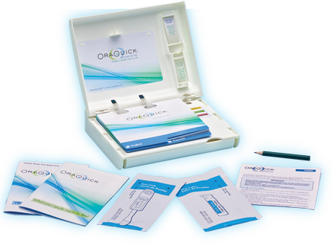
Home Based Testing
Oraquick In-Home HIV Test
FDA approved July 3, 2012
First OTC home use rapid test – HIV 1 and HIV 2
Specimen: oral fluid
92% sensitivity/ 99.98% specificity
Consumer support center available 24/7
Available in October 2012
Notes:
http://www.fda.gov/NewsEvents/Newsroom/PressAnnouncements/ucm310542.htm
Modified version of Oraquick Advance Rapid HIV 1/2 antibody test for use with oral fluid specimens
Test kit includes 2 informational books – “HIV, Testing and Me” and “What Your Results mean to You!”
Cost - ? At this time (August 2012)
- Positive test requires confirmatory test
- According to the FDA, “the test has the potential to identify large numbers of previously undiagnosed HIV infections especially if used by those unlikely to use standard screening methods.”
“Clinical studies for self-testing have shown that the OraQuick In-Home HIV Test has an expected performance of 92 percent for test sensitivity, the percentage of results that will be positive when HIV is present. This means that one false negative result would be expected out of every 12 test results in HIV-infected individuals.
Clinical studies also have shown that the OraQuick In-Home HIV Test has an expected performance of 99.98 percent for test specificity, the percentage of results that will be negative when HIV is not present. This means that one false positive would be expected out of every 5,000 test results in uninfected individuals.”
Consumer support center will be available to educate users with information about HIV/AIDS, the proper method for administering the test and guidance on what to do once results have been obtained.
The home test will be available in pharmacies, grocery stores and online retailers by October 2012

Slide 29
When is a Rapid Test Indicated?
Primary care offices
Urgent care clinics, acute care setting
L & D admissions
Occupational exposures/employee health
ED
STI clinics
Drug treatment clinics (WV methadone clinics?)
Public health community settings
Developing countries
Prisons

Slide 30
Encourage HIV testing
Raise your HIV antennae in patients with
  STI
  Pregnancy
  Active TB
  Females with refractory or recurrent vaginal candidiasis
  Anyone who requests it

Slide 31
Keep HIV on the radar screen
Generalized lymphadenopathy
Unexplained dementia
Aseptic meningitis
Peripheral neuropathy
Chronic, unexplained fever
Diarrhea
Weight loss
Multidermatomal herpes zoster
Unexplained cytopenias
B-cell lymphoma
Diagnoses suggestive of cell- mediated immunodeficiency

Slide 32
Necessity of HIV Testing in the Primary Care Setting
Offering routine HIV testing in the primary care setting is de-stigmatizing:
  Normalization is key
  Consider as any other routine, evidence based screenings ie: colorectal cancer, BP, lipids, STDs…
Improved patient outcomes:
  Later diagnosis of HIV = sicker people = more people are sick than would be in the case of earlier diagnosis
  Case identification = linkage to care, initiation of ARV therapy = undetectable viral load = no transmission to partners
Improved public health outcomes:
  Drastic decrease in new infections→→→→

Slide 33
CDC Recs. Since 2006
Silence = infection:
  Case goes undiagnosed→ missed opportunity for behavior change, reduction in viral load, increased likelihood of transmission to partners (sexual/IDU)
  CDC recommendations, National Priority and US Preventative Task Force (USPSTF) all reflect the role of primary care providers in breaking the silence: providing routine HIV screening for your patients
Notes:
Test all persons between the ages of 13-64
Annual testing for those at greater risk
Offer testing to all pregnant women, and again in 1st trimester

Slide 34
Components of a Successful Screening System
Staff training including front desk
  HIV fundamentals, stigma, patient/public health outcomes
Champions:
  Change leaders
Supportive EHR workflows
Patient communication prior to and after screening
  We ask all of our patients…..
Data reports
QI plan integration
Partnerships within and outside of your health center

Slide 35


Build and Expand Partnerships
Carolyn, Jeannette and Sara at the MidAtlantic AETC!!
Ryan White Clinics in WV
Part B Case Managers
WVU MARSline to refer positives for initiation of ARV therapy
  Remember you can do the primary care yourselves!
Other primary care or community health centers that currently offer HIV testing
WV State Health Department

